Slide 1
Act2: In Response to God’s Call
Presbytery of Port Phillip East
Presbytery in Council meeting August 2023
Jessica Hateley-Browne
Act2 National Steering Group Member

Slide 2
Act2 is a major transformational change project for the UCA
The UCA is living through a time of change, opportunity and challenge.
The call of the Basis of Union is to always consider our life afresh, led by the Spirit.
Act2 project was born in response.
An invitation to every church member, council and community to discern together where God is calling us.
Act2 is here to support and enable the UCA to be a vibrant and sustainable witness in the modern context, as the Church we are now.
Notes:
In March 2020, the Assembly Standing Committee recognised that the Uniting Church in Australia is living through a time of massive change, opportunity and challenge.
Hearing the call of the Basis of Union to always consider our life afresh, and as a Church that continually seeks the leading of the Spirit, the Act2 Project was born.
Act2 is an invitation to every Uniting Church member, council and community to discern together where God is calling us into the future.
We are looking at our life and asking: we do we need to do, and what do we need to change, to fully live out our shared identity, unity and commitment to God’s mission?
We’re celebrating our strengths and our identity shaped over many decades, and facing our challenges.
To work towards a faithful future, we must be honest about the past and present as we seek to follow Jesus in a radically changed context.
Act2 is here to support and enable the UCA to embody its identity and be a vibrant and sustainable witness in 21st century Australia, and as the Church we are now.

Slide 3
TIMELINE

Slide 4
WORKSTREAMS
CORE COMMITMENTS

Slide 5
WORKSTREAMS
CORE COMMITMENTS

Slide 6
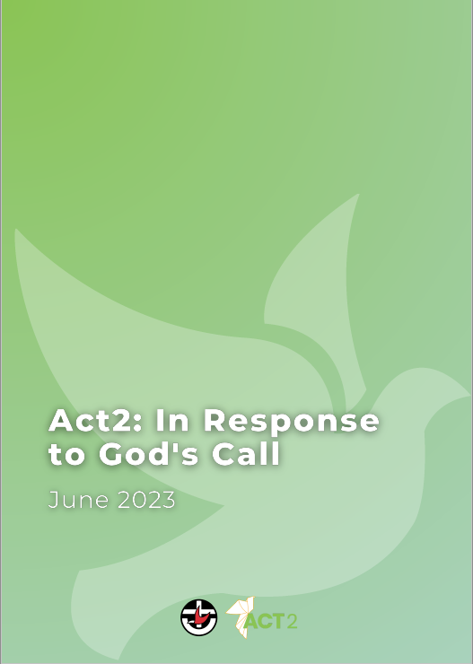
act2uca.com/act2report

Slide 7
Why is Act2 important for presbyteries?
Every Presbytery was contacted by the Act2 team during the Exploration Phase. In consultations, it was clear that:
Presbyteries
a source of support and encouragement to congregations
play an intermediary role for administration and compliance.
Presbyteries face challenges in balancing support for new/growing communities, and support for declining communities.
Experiences with Presbyteries are very mixed, partly driven by variations in responsibilities and resources:
“Some Presbyteries have personnel of more than ten while others run entirely on the contribution of people in other ministry roles. Some cover thousands of kilometers across metropolitan, provincial, rural and remote contexts while others are contained within one part of a metropolitan centre. Some have more than 100 communities of faith while others have less than 20. Some have accumulated substantial financial reserves while others live on an annual budget with limited financial buffer.”
Of all the councils, Presbyteries have the greatest gap between their responsibilities and their resourcing
Act2 seeks to offer directions and options that respond to these challenges and resolve some od these tensions.
Notes:
Every Presbytery was contacted by the Act2 team during the Exploration Phase. In consultations, it was clear that:
Congregations describe Presbyteries as a source of support and encouragement, and as playing a role as an intermediary for administration and compliance.
Presbyteries report facing challenges in balancing supporting new/growing communities with the support needs of declining communities.
Individual and congregational experiences with Presbyteries are very mixed - in part because of wide variations in responsibilities and resources:
“Some Presbyteries have personnel of more than ten while others run entirely on the contribution of people in other ministry roles. Some cover thousands of kilometers across metropolitan, provincial, rural and remote contexts while others are contained within one part of a metropolitan centre. Some have more than 100 communities of faith while others have less than 20. Some have accumulated substantial financial reserves while others live on an annual budget with limited financial buffer.”
Of all the councils, Presbyteries have the greatest gap between their responsibilities and their resourcing
Act2 seeks to offer directions and options that respond to these challenges and resolve some od these tensions.

Slide 9
Notes:
https://vimeo.com/847851917

Slide 11
Notes:
https://vimeo.com/847849063

Slide 12
Discernment Questions for Councils of the Church
Workstream 1: Directions
Workstream 3: Options
For each direction, is your group:
Supportive
Open
Not supportive
What affirmations, questions or concerns do you have about any of these directions?
For each option, is your group:
Supportive
Open
Not supportive
For each option, what affirmations, questions or concerns do you have about this option?

Slide 13
Stay connected…
Email me:
jhateleybrowne@gmail.com
Email Act2 Project Assembly team:
UCA.Act2@nat.uca.org.au
Ask a question, make a personal submission, find more resources:
www.act2uca.com/act2report
Stay in touch:
Sign up to National Update

